Slide 1
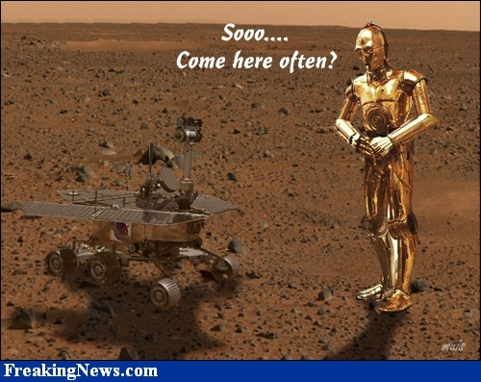
Team 6 Final Challenge!
Team 6 (The Sentinels) is…
Neil Forrester
Daniel Gonzalez
Raghavendra Srinivasan
James Wiken

Slide 2
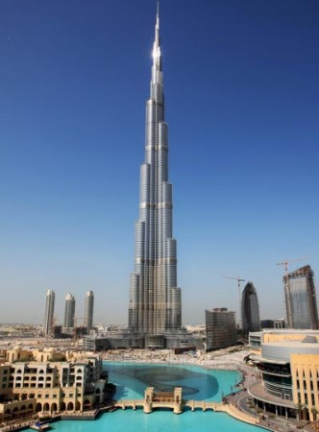
Challenge Goal
Given a rough map of the environment, a plan for a building, and building materials strewn throughout the environment...
Localize, collect materials, and build the predetermined structure.

Slide 3
Achieving our Goal
Our robot must:
  Navigate Environment
  Locate and Collect Building Materials
  Transport Materials to Construction Zone
  Assemble Materials into a Structure

Slide 4
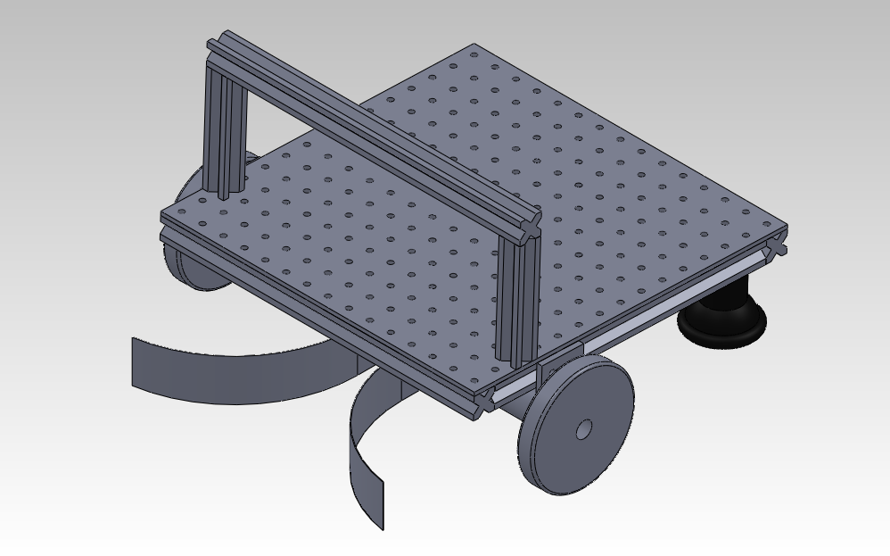
High-level approach
Collection
  Localization and navigation
  Searching
  Funnel and visual servoing
Assembly
  Dropping off blocks for assembly
  Manipulator assembles structure block by block

Slide 5
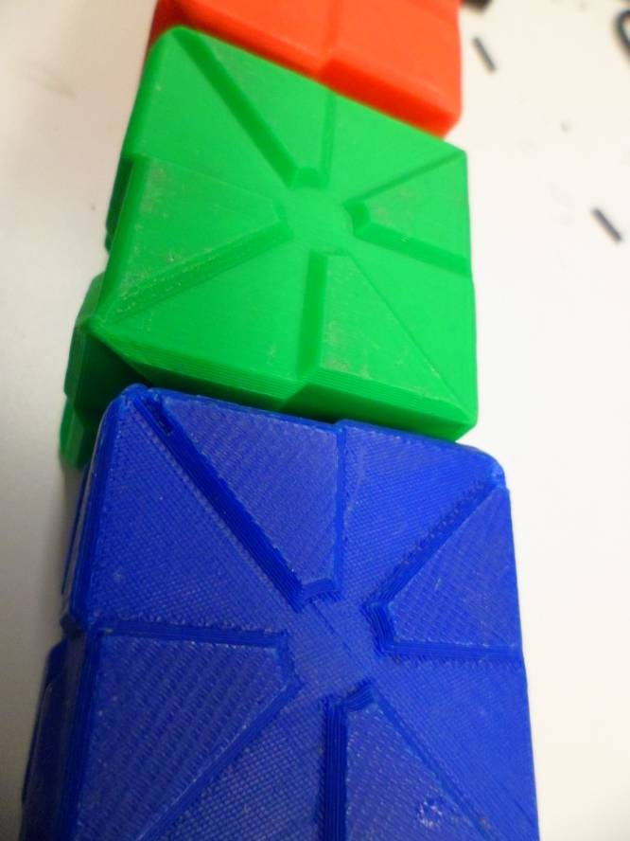
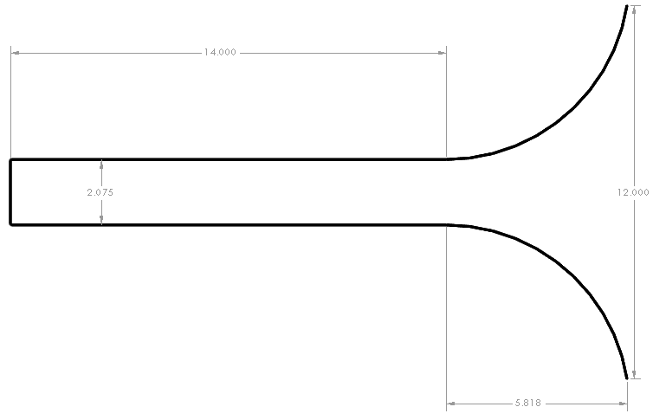
Mechanical Systems: Funnel
Sheet metal cut and bent to shape
Standoffs hold it secure to the frame
Inner width optimized for proper inter-block interfacing

Slide 6
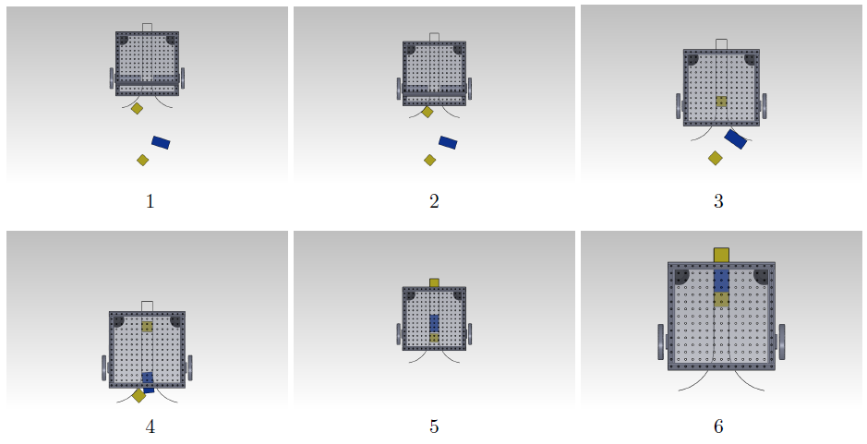
Mechanical Systems: Funnel
Solidworks Simulation Results
Robust against strange placement and visual servoing error.

Slide 7
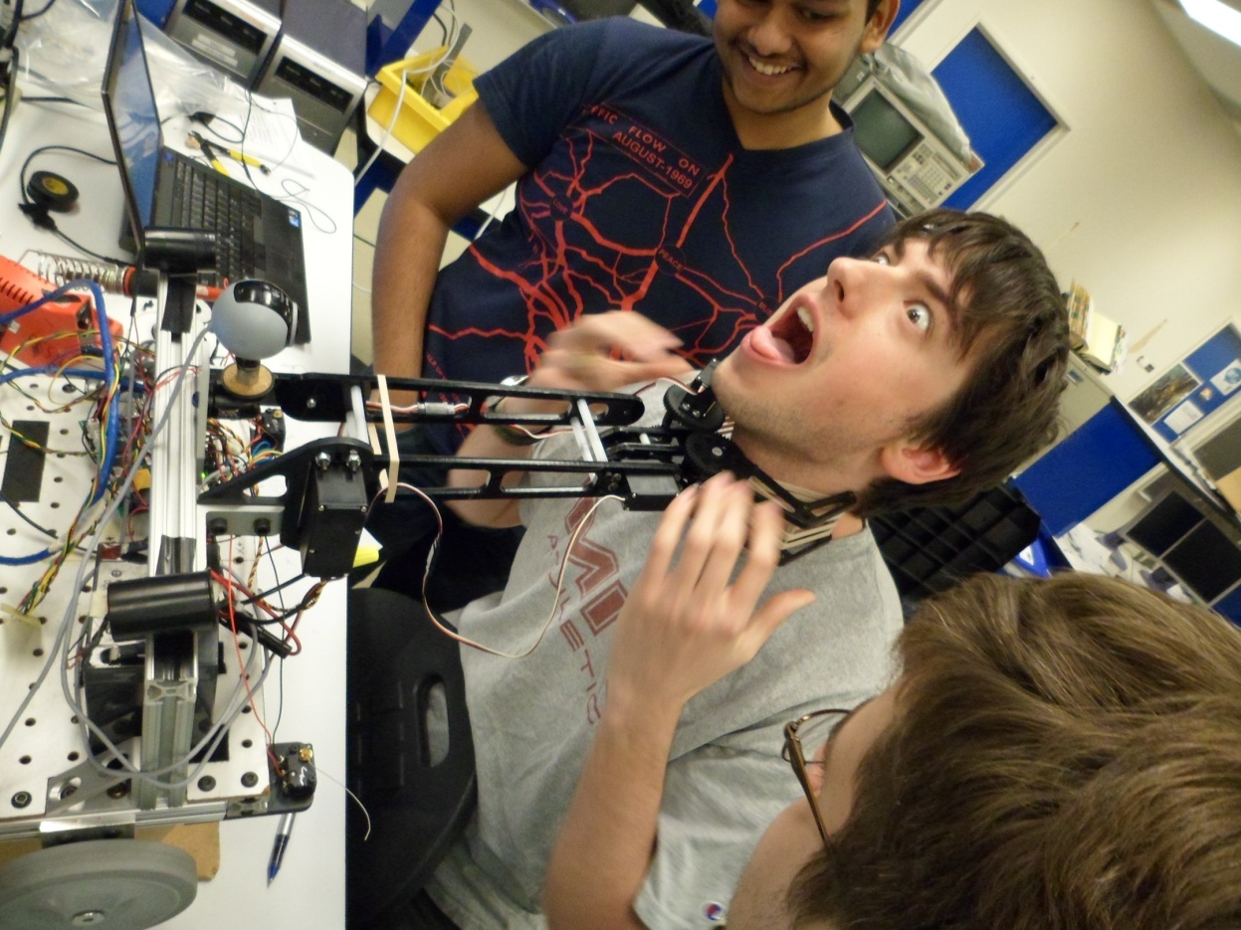
Mechanical Systems: Manipulator
After extensive testing, the Lab 7 manipulator proved to be sufficient for our purposes.

Slide 8
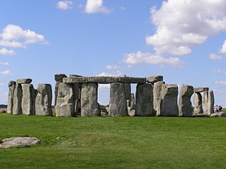
Special Focus: Manipulation
Building arbitrary structures is a challenge, and we’ve allocated significant development time to this.
After collecting blocks quickly with the funnel, the robot will use the robot arm to build fancy things, such as Plastichenge.

Slide 9
Mechanical Systems:
Motor Control Systems
PID Control
  Encoder feedback for general navigation
  Visual servo feedback for block collection allignment.
Different Gains for different situations
Optimize for time constraint

Slide 10
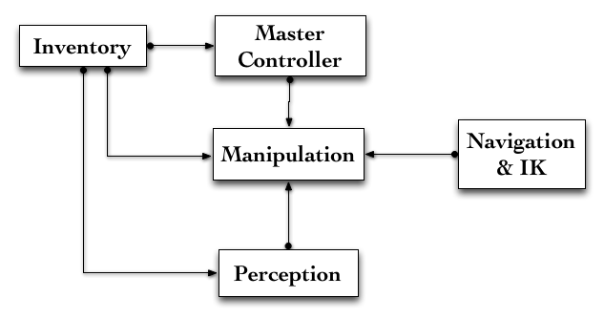
Software Systems: Architecture

Slide 11
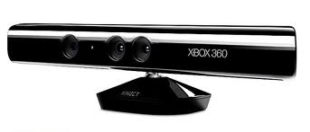
Kinect as a camera alternative
If a Kinect turns out to be practical and useful, we could use it instead of (or in addition to) the webcam.

Slide 12
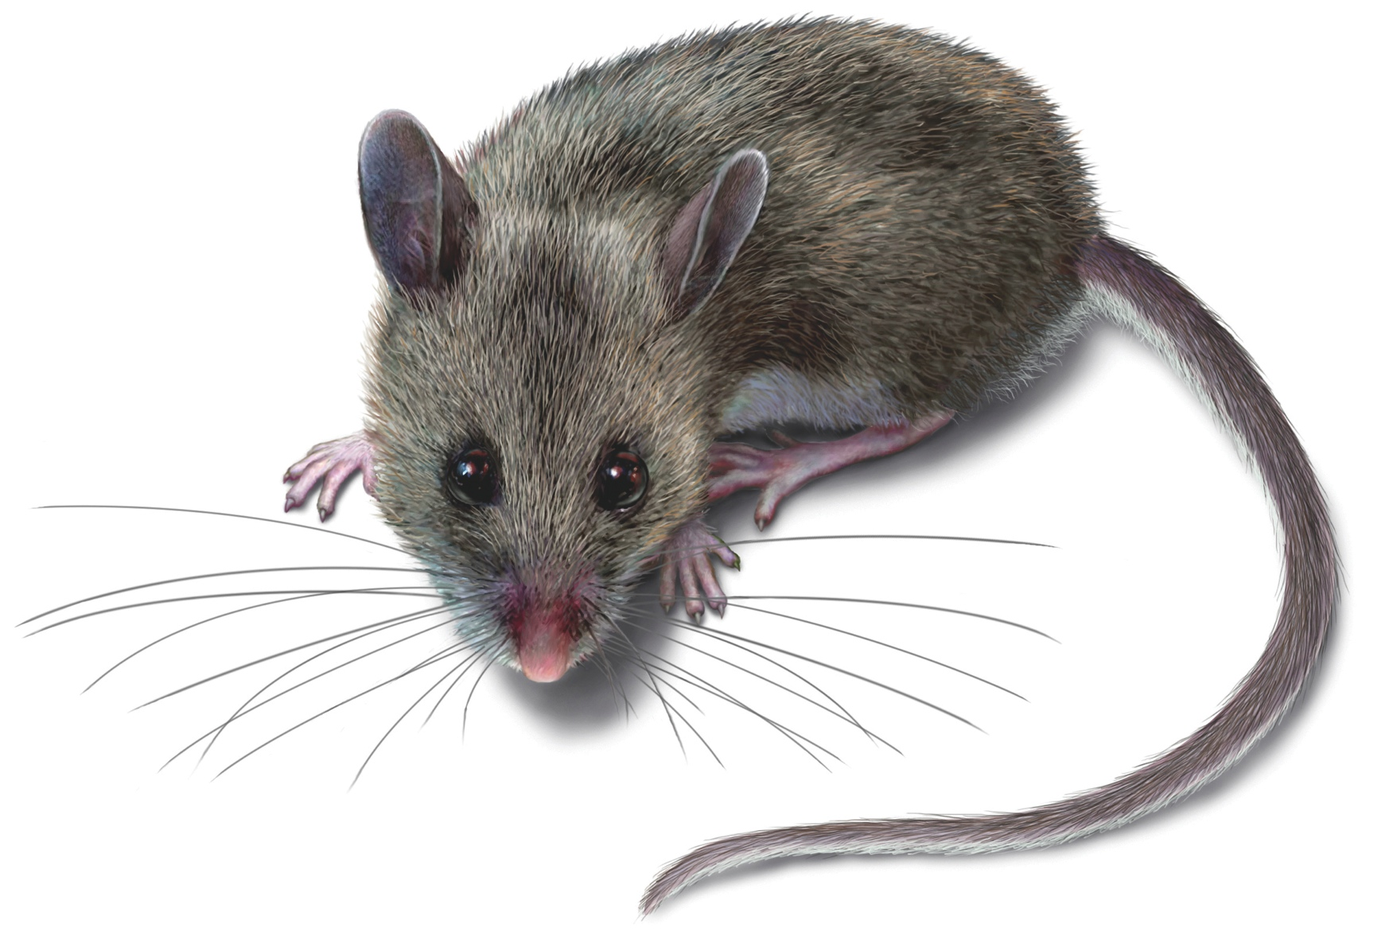
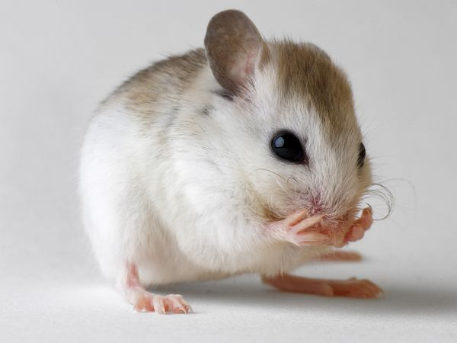
Mice for localization
Using mice for more accurate odometry than the quadrature encoders in the wheels.
We can use bayes rule to combine input from multiple sources (wheel encoders, mice, camera seeing fiducials, etc)

Slide 13
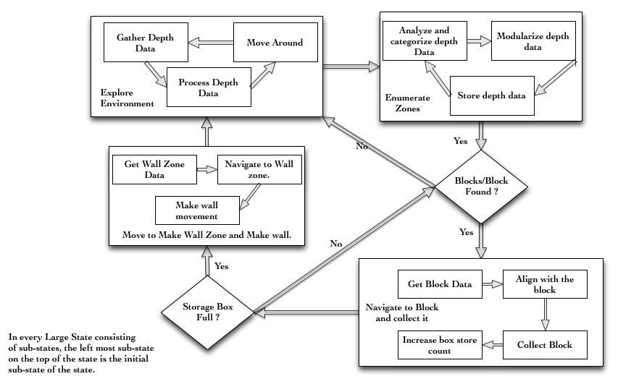
State Diagram: Collection Phase

Slide 14
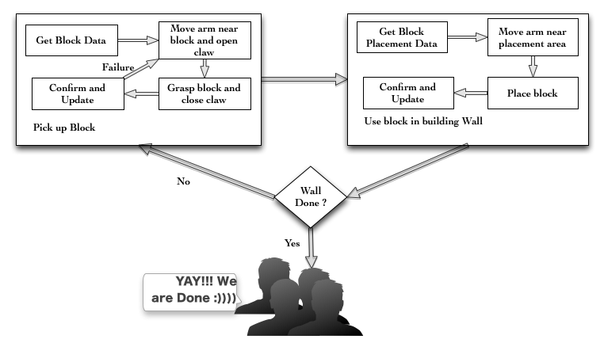
State Diagram: Assembly Phase

Slide 15
Possible Problems
In spite of careful design and simulation, the funnel jamming is conceivable.
Vision (with a webcam or kinect) might be more difficult than anticipated. In particular, detecting the orientation of the blocks might prove difficult.
The robot arm might require closed loop control with vision to place blocks accurately, which would be a pain.

Slide 16
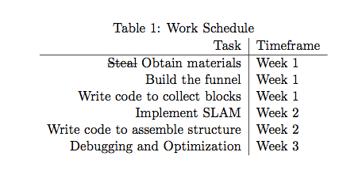
Schedule

